Slide 1
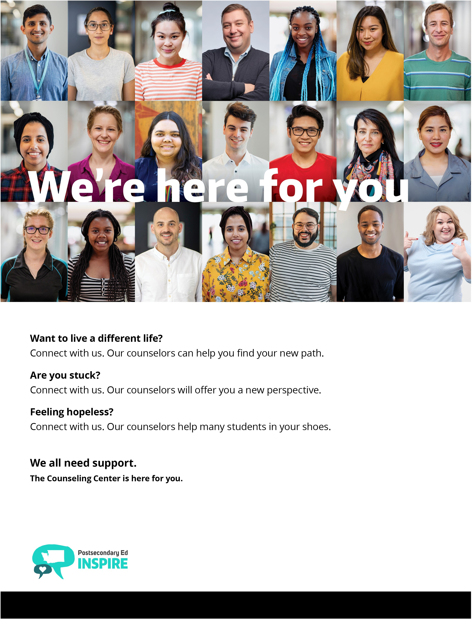
Physical address, including user-friendly directions if needed Counseling Center website URL

Slide 2
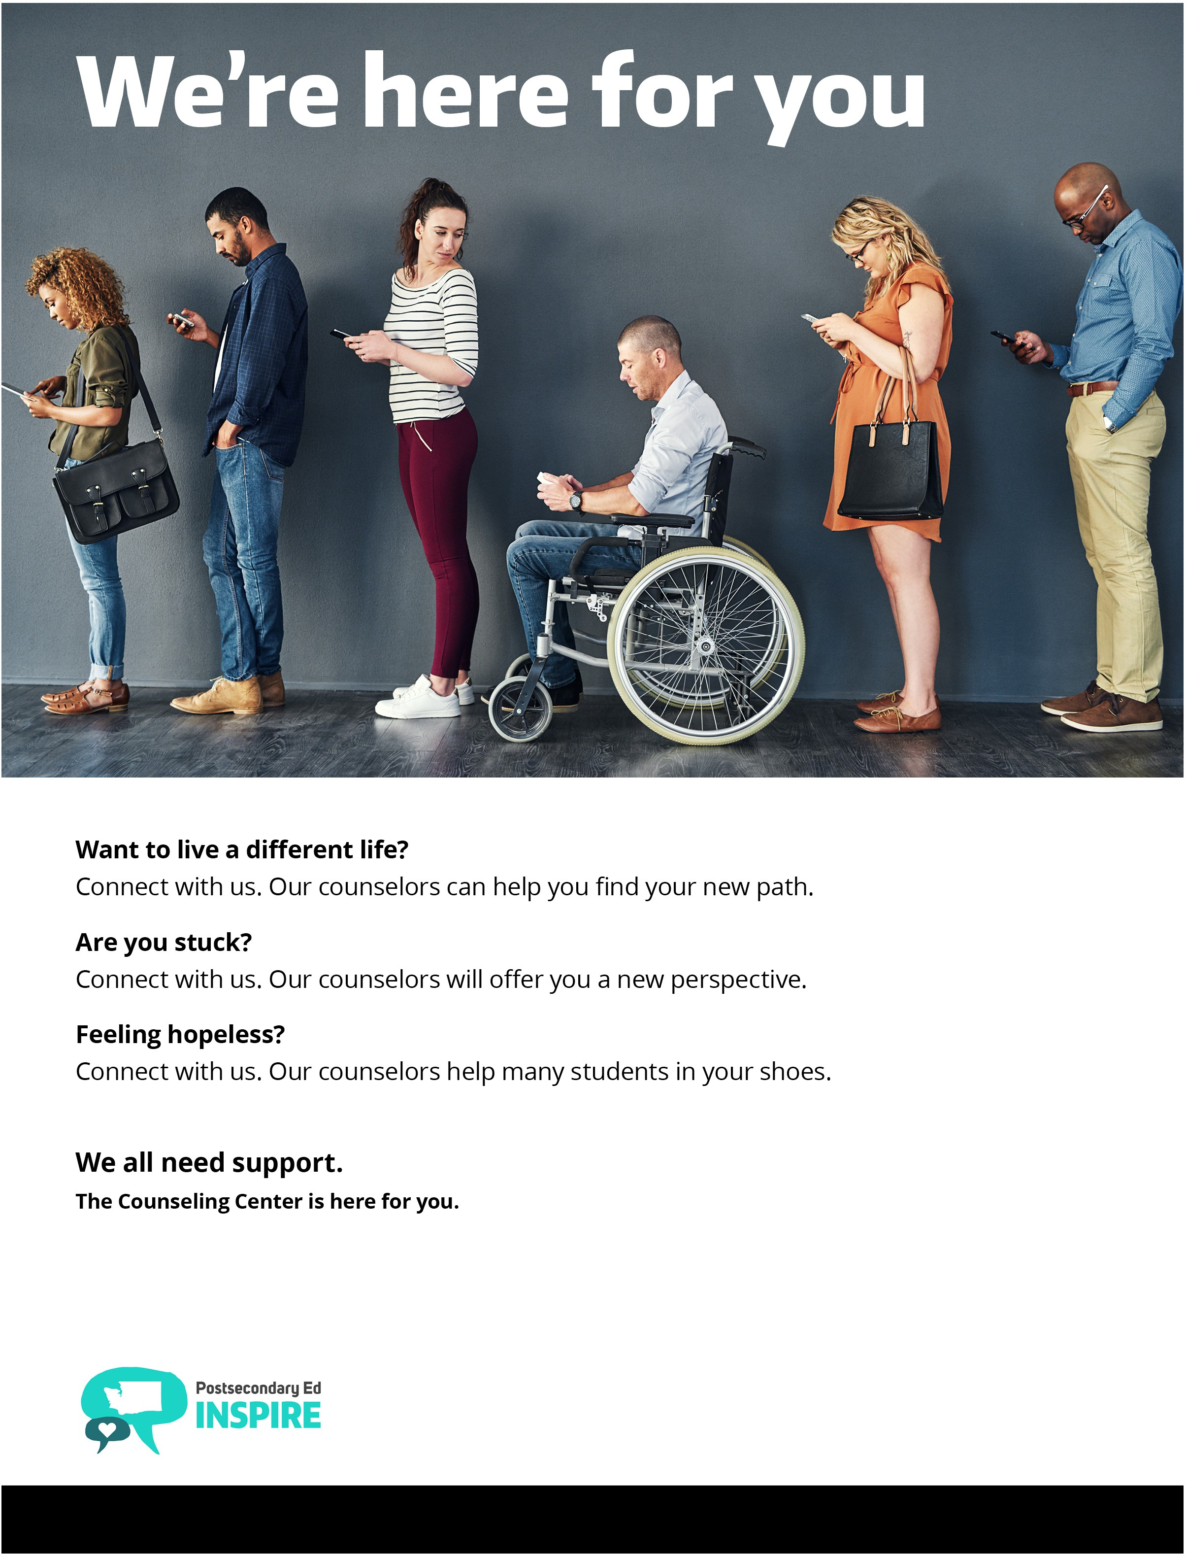
Physical address, including user-friendly directions if needed Counseling Center website URL

Slide 3
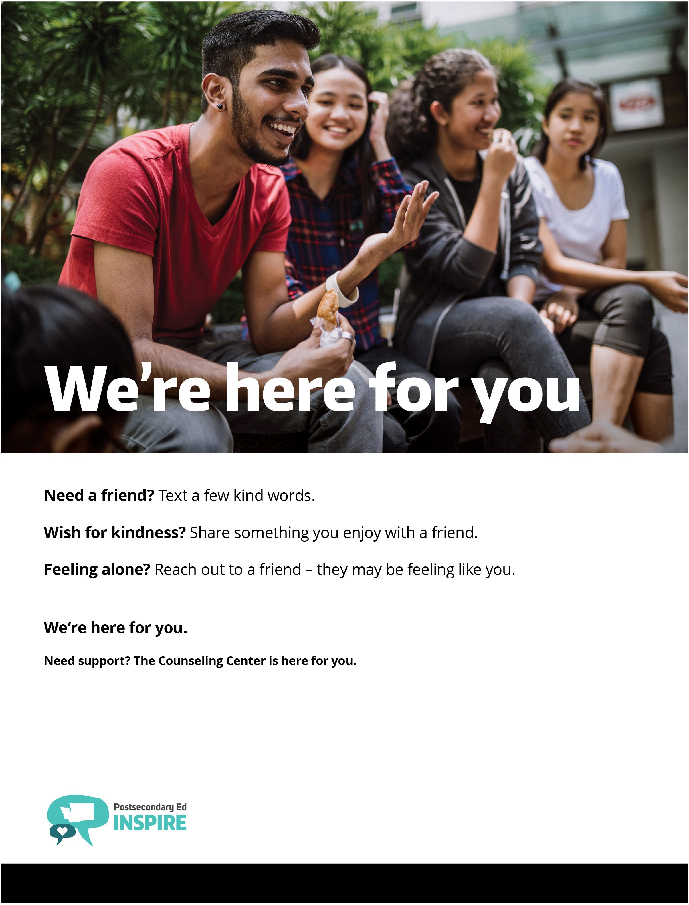
Physical address, including user-friendly directions if needed Counseling Center website URL

Slide 4
Physical address, including user-friendly directions if needed Counseling Center website URL

Slide 5
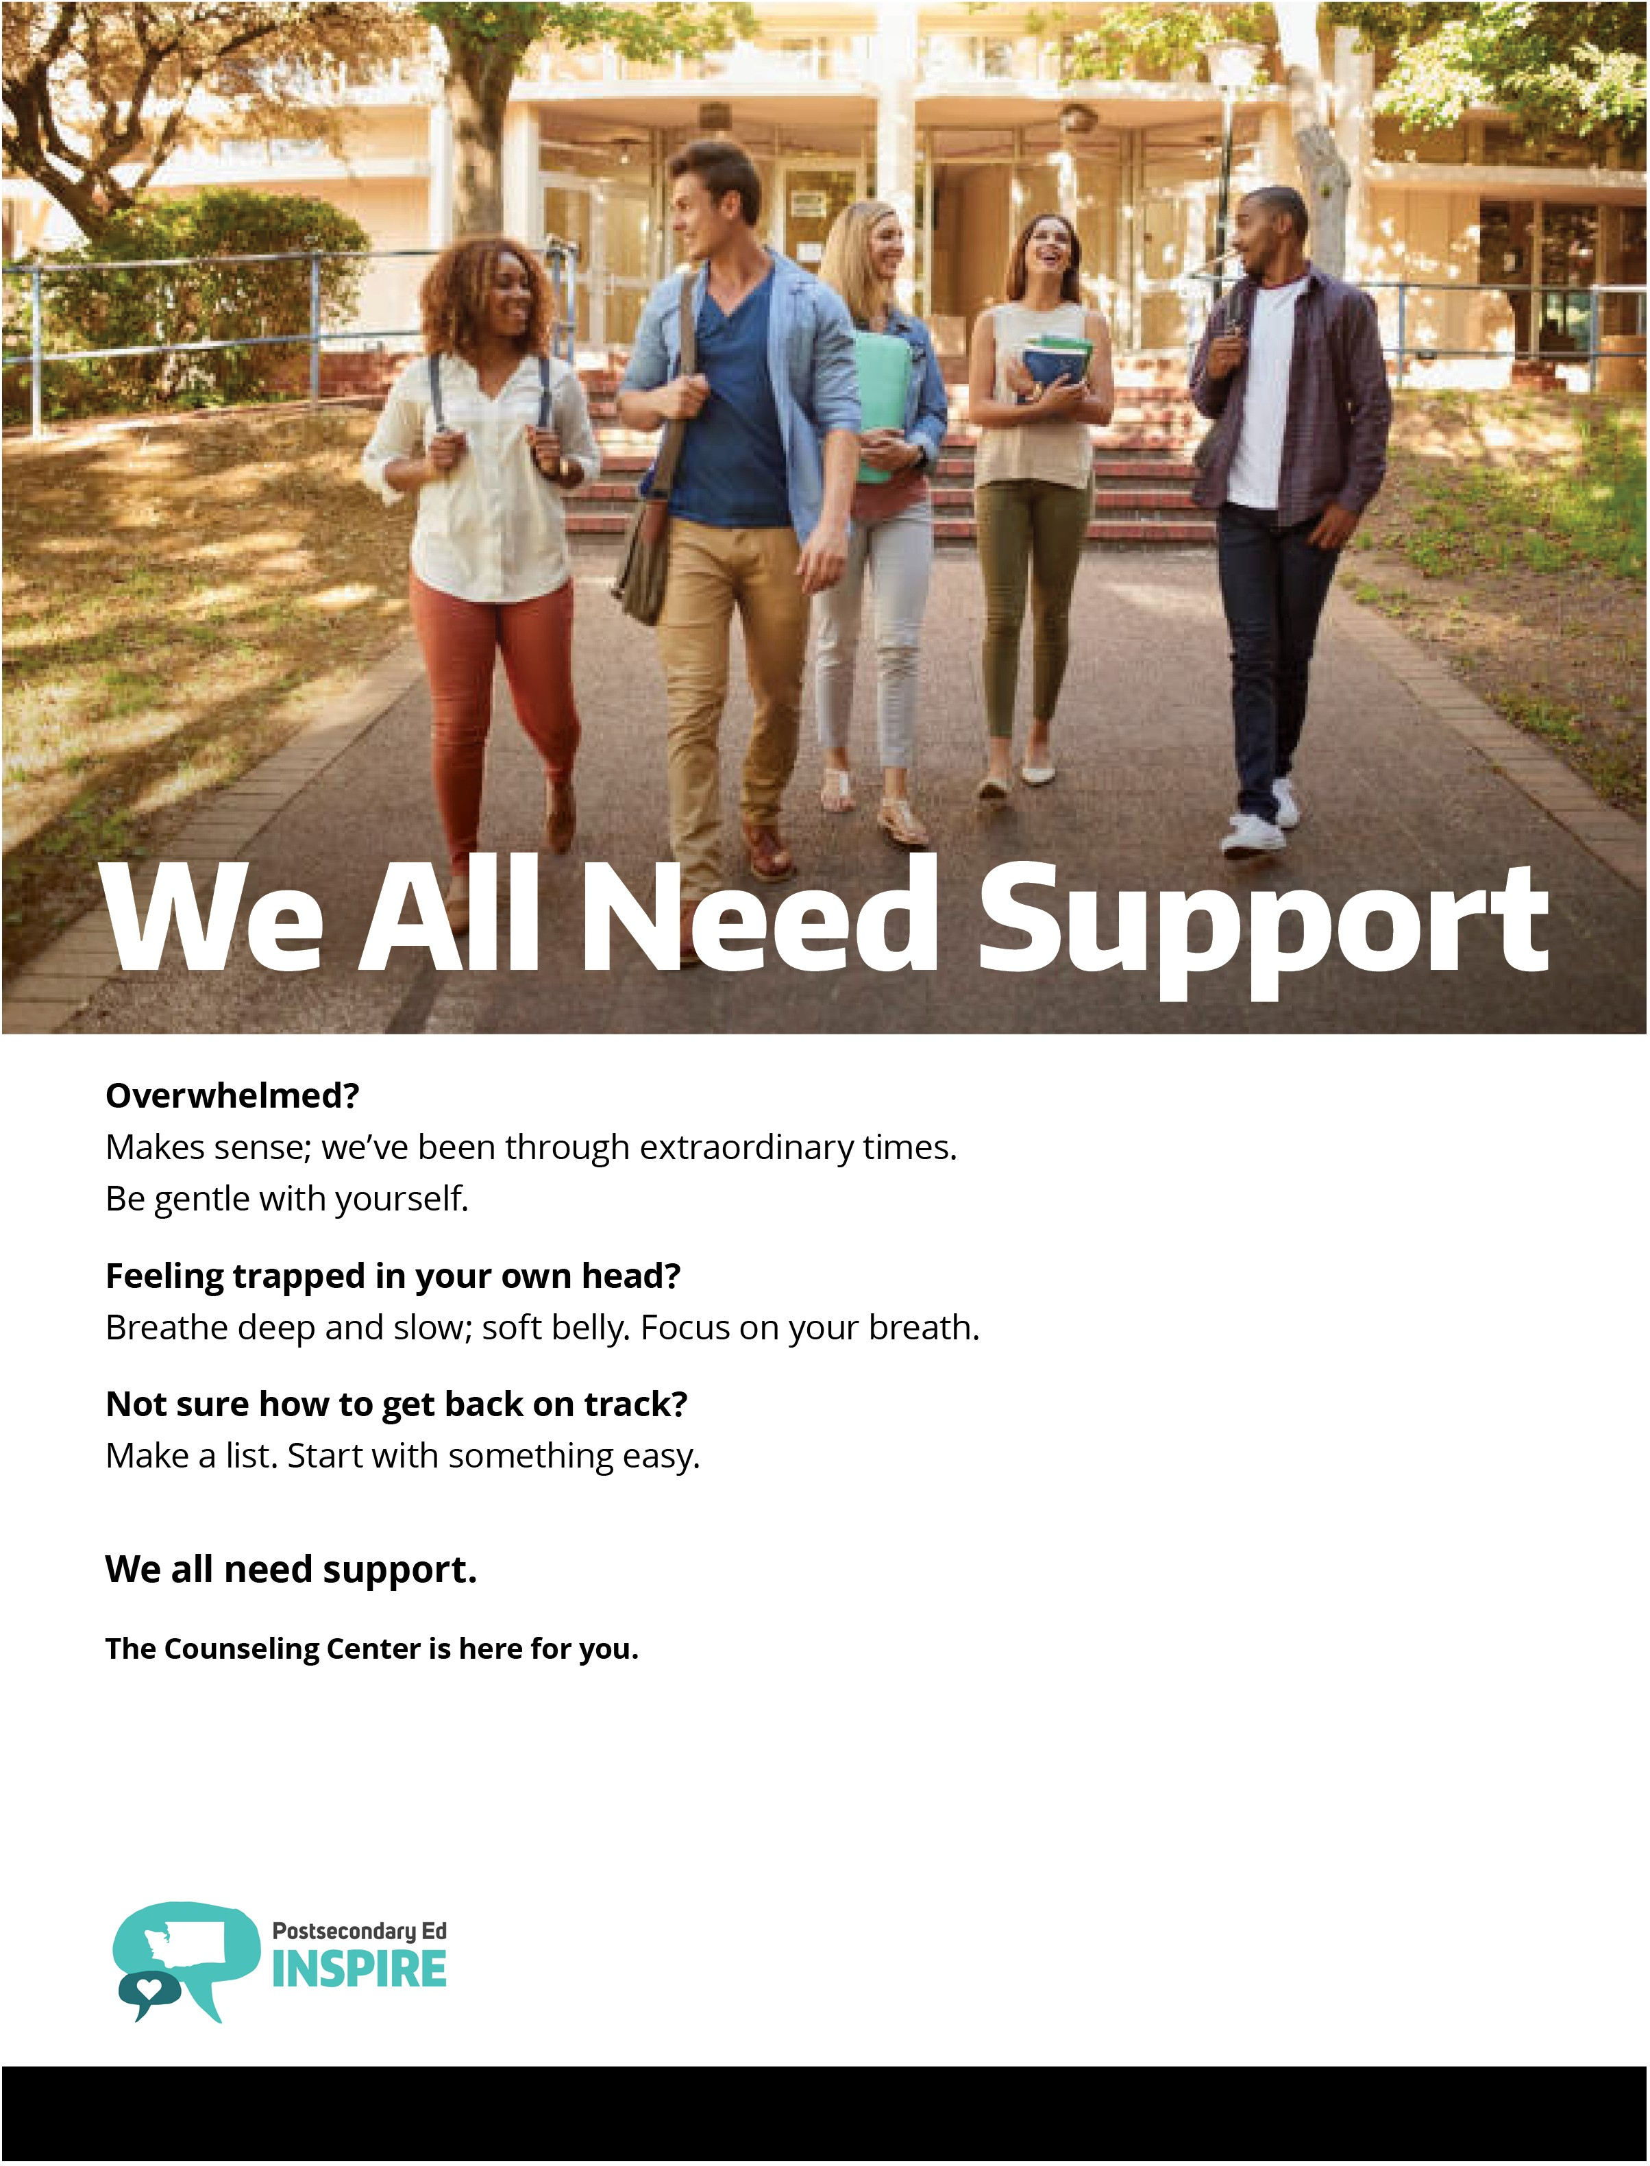
Physical address, including user-friendly directions if needed Counseling Center website URL

Slide 6
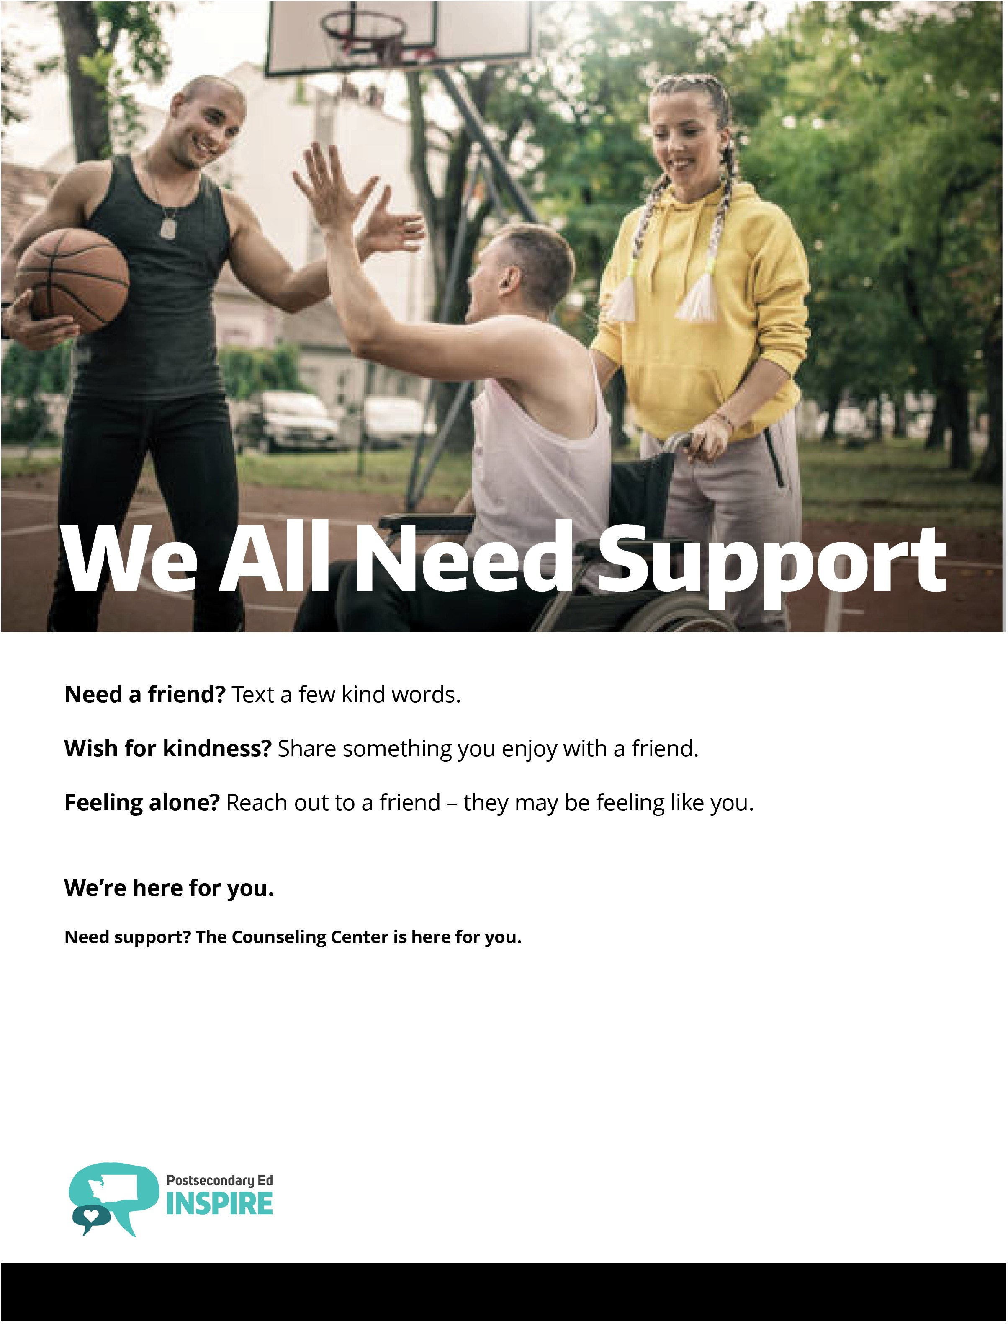
Physical address, including user-friendly directions if needed Counseling Center website URL

